Slide 1
Project 3 Presentation

Slide 2
Members
Alton Stovall
Emmy Perez
Jacques Crawford
Prashikh Agrawal
Tej Patel
Mia Abrams
Notes:
Jacques

Slide 3
Topic - Social Networks and Learning
Student Suggestions related to Student Life including Individual Student Challenges
Unsupervised Learning
Sample Data collected from students enrolled in ECE 4605
Students viewed data results
Contributed sample data once more after viewing network data
Notes:
Mia

Slide 4
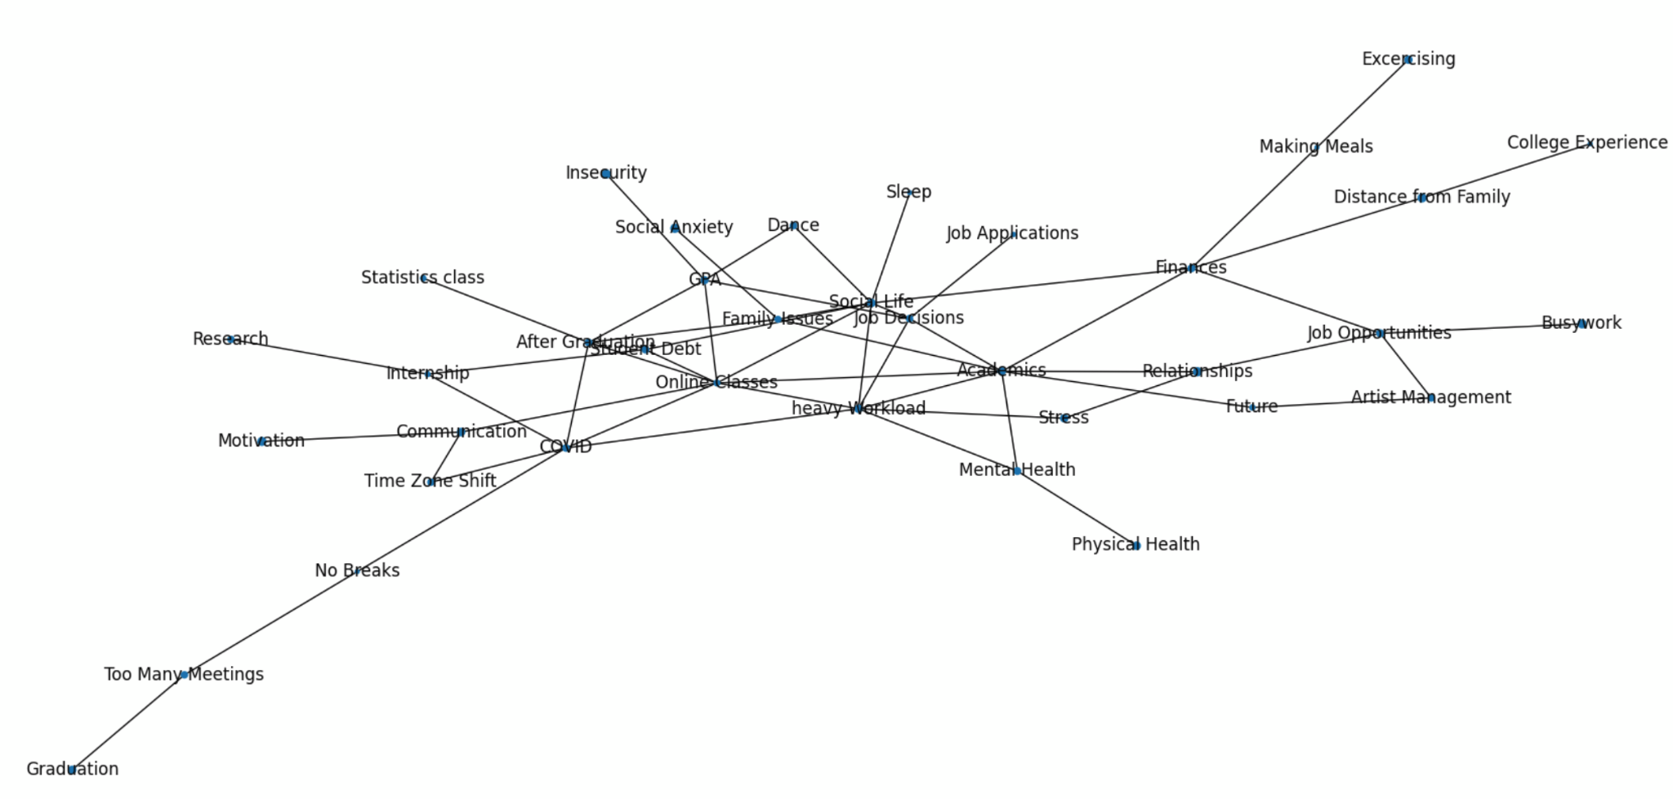
Node Graphing (Part A)
Our original node graph from project 1 representing the ideas that administration could improve on.
More analysis given in Part E conclusion.

Slide 5
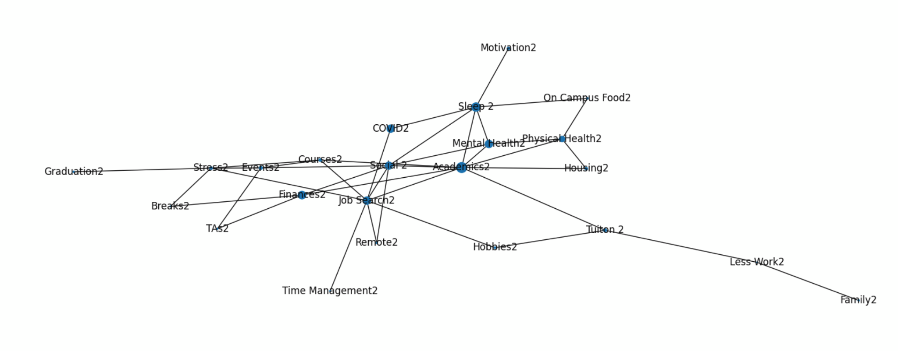
Node Graphing Continued (Part A)
Second layer of the node graph depicting the challenges each student reported and the associated weights given to them
“2” was added to the end of each challenge to help depict the differences in node mappings when both graphs were plotted on the same plane
Node sizes are based on count given to each node and means of their ratings

Slide 6
Clustering Algorithm Explanation (Part B)
We have created a k-means clustering algorithm to cluster the common categories for students together
The clusters were created by using a coordinate system where “x” represents the concern and “y” represents the rating given to it
These were then clustered based on corresponding ratings using K-means with the “sklearn.datasets” library
The clustering algorithm used aims to correlate concern ratings for each challenge that students selected
We cluster based on the rating and challenge similarity, with 5 clusters shown.
The concern axis shows the challenges that were brought up by students, in the order given from the data set (selection of challenges shown on next slide)
The next slide shows the clusters and what they represent.
Notes:
Tej

Slide 7
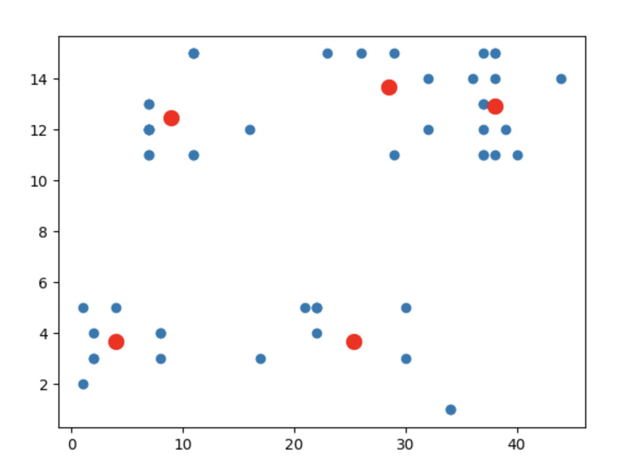
Clustering Algorithm Data (Part B)
Cluster | Concerns
1 | Mental/Physical Health, Housing, Academics
2 | Hobbies, Motivation, Remote
3 | Finances, Social, Academics
4 | Courses, Hybrid Classes, Motivation
5 | Job Search, Stress, Graduation
3
4
5
Rating
2
1
Concern

Slide 8
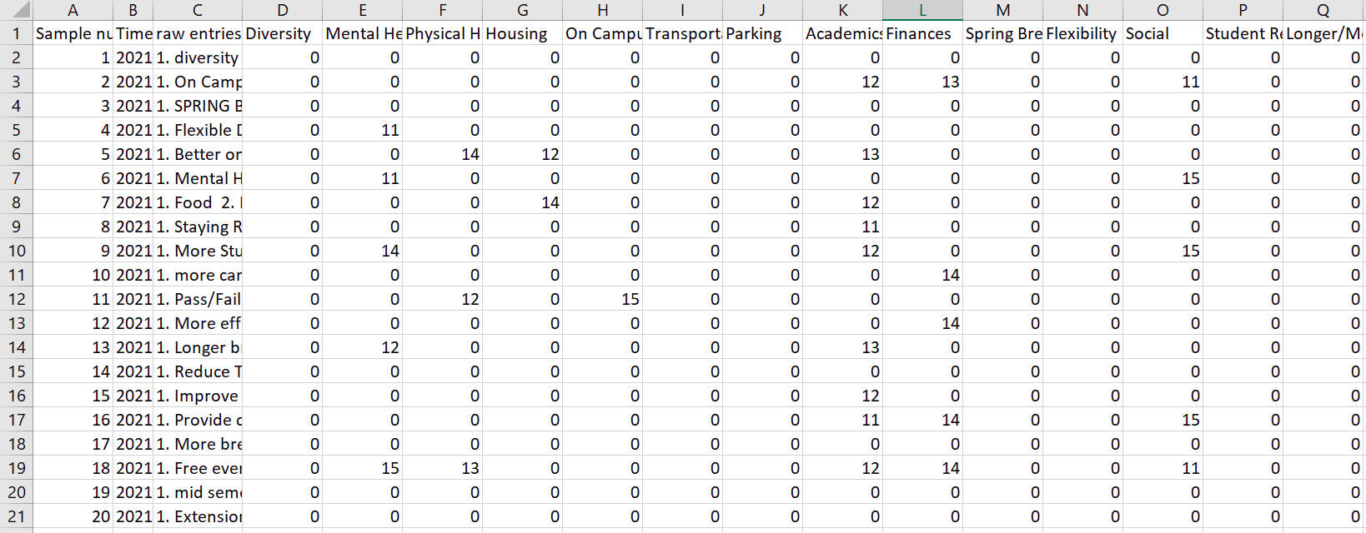
Feature Vectors (Part C)
Our feature vectors filtered the given data into two different files, one for student challenges (data features 11 to 15), and another for student suggestions for faculty (data features 1 to 5).
A small excerpt of each is shown, but the full feature vectors can be found in our submitted files as “post_processed_11to15.csv” and “post_processed_1to5.csv”.
post_processed_11to15.csv

Slide 9
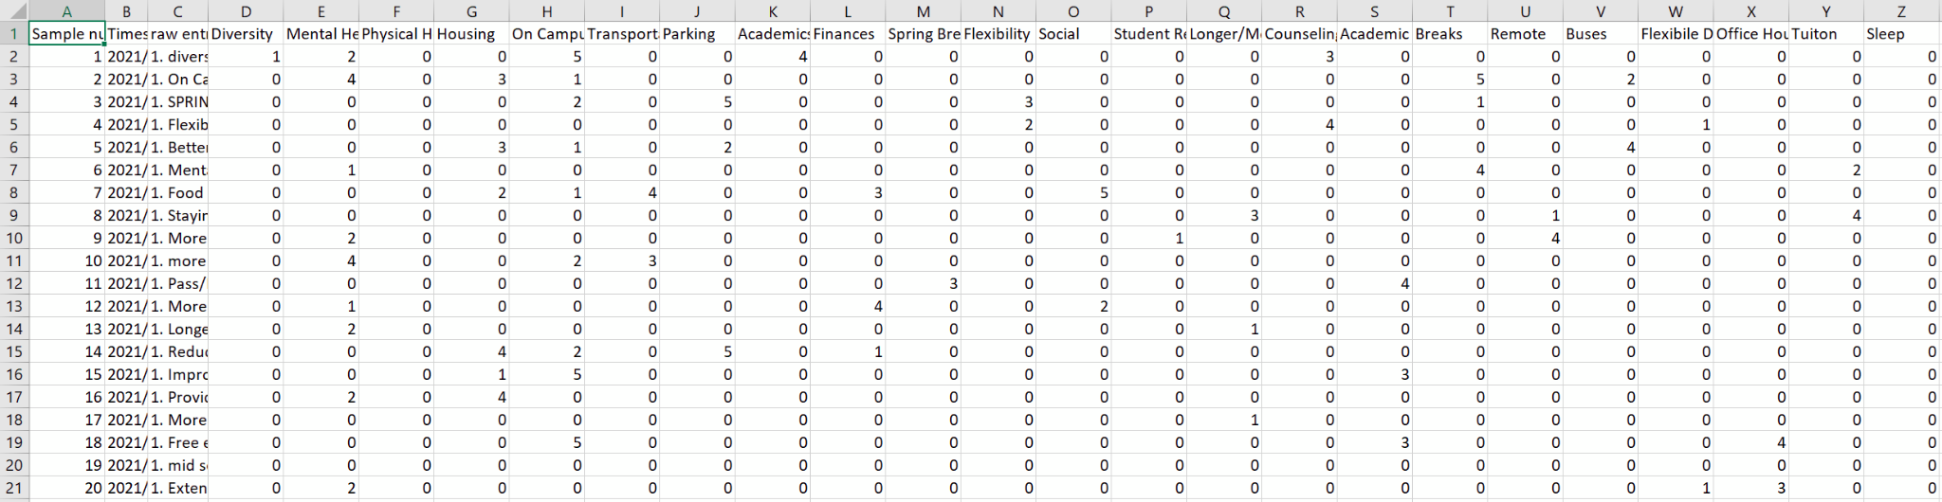
Feature Vectors (Part C)
A small excerpt from “post_processed_1to5.csv” show below. Each row reflects a student, and each column is the challenge.

Slide 10

Matrix Factorization (Part D)
We composed the data into two different matrices from the feature vectors created in Part C
Using the matrix factorization library “mf.py” (source cited in code), we were able to run our feature vectors (both for 1 to 5 and 11 to 15) through factorization where the data points that were 0 for each student were “learned” or approximated from values that were existing for the latent features.
This factorization library develops two matrices. One is user to latent features (P), and the other is data to latent features (Q).
The following gradient descent is used to calculate the minimum difference to find the missing rating
Reference: https://albertauyeung.github.io/2017/04/23/python-matrix-factorization.html
Notes:
Reference: https://albertauyeung.github.io/2017/04/23/python-matrix-factorization.html

Slide 11
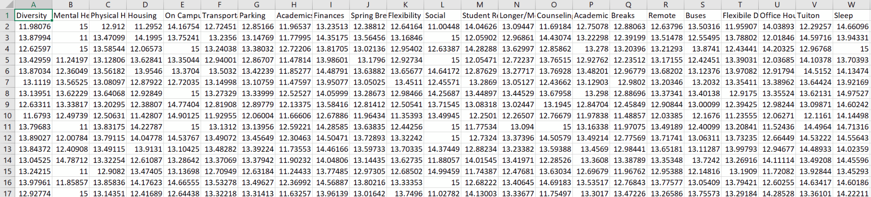
Matrix Factorization Continued (Part D)
The entire process can be summarized with the following iterative operation to check for the stopping point of rating prediction (error checking):
The learned matrices are also located in the files submitted, they are called “learned_ranges_11to15.csv” and “learned_ranges_1to5.csv”
A small excerpt from “learned_ranges_11to15.csv” show below. Each row reflects a student, and each column is the challenge. Low/high estimated data has been filtered to the lower and upper limits respectively.

Slide 12
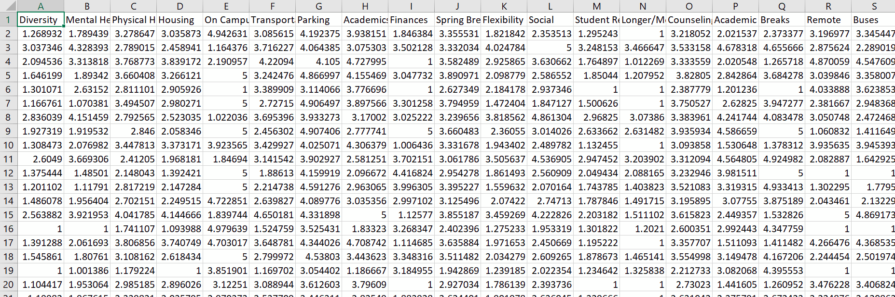
Matrix Factorization Continued (Part D)
A small excerpt shown from “learned_ranges_1to5.csv”. Once again the low and high estimates were filtered to the lower and upper bounds respectively.

Slide 13
Correlations (Part E)
Cluster | Concerns
1 | Mental/Physical Health, Housing, Academics
2 | Hobbies, Motivation, Remote
3 | Finances, Social, Academics
4 | Courses, Hybrid Classes, Motivation
5 | Job Search, Stress, Graduation
3
4
5
Rating
2
1
Concern
Academics and Motivation exhibit correlation between student challenges and student life concerns as found from the clustered data

Slide 14
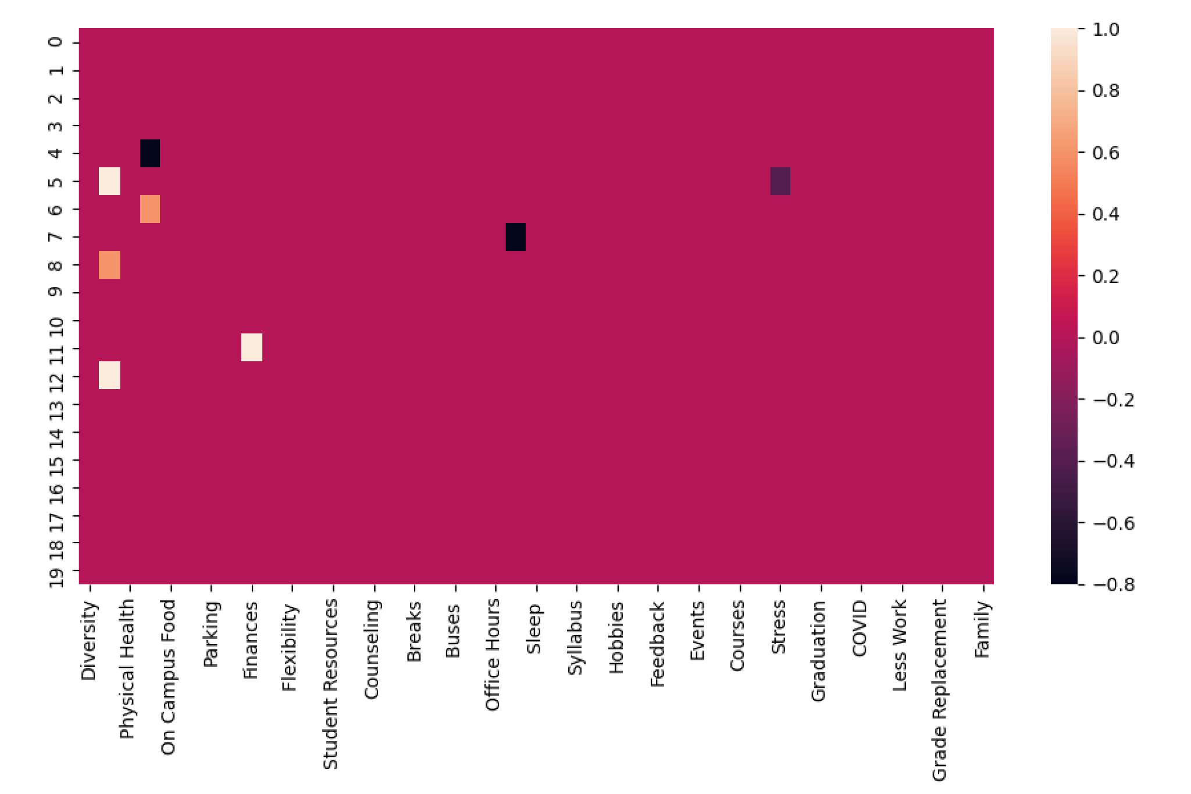
Correlations Continued (Part E)
This correlation map is a representation of the relative “distance” between student challenges and suggestions by measuring the difference found in each student. A correlation factor of 1 or -1 represents a strong connection between strengths and challenges, and reduces to 0 (no correlation).

Slide 15
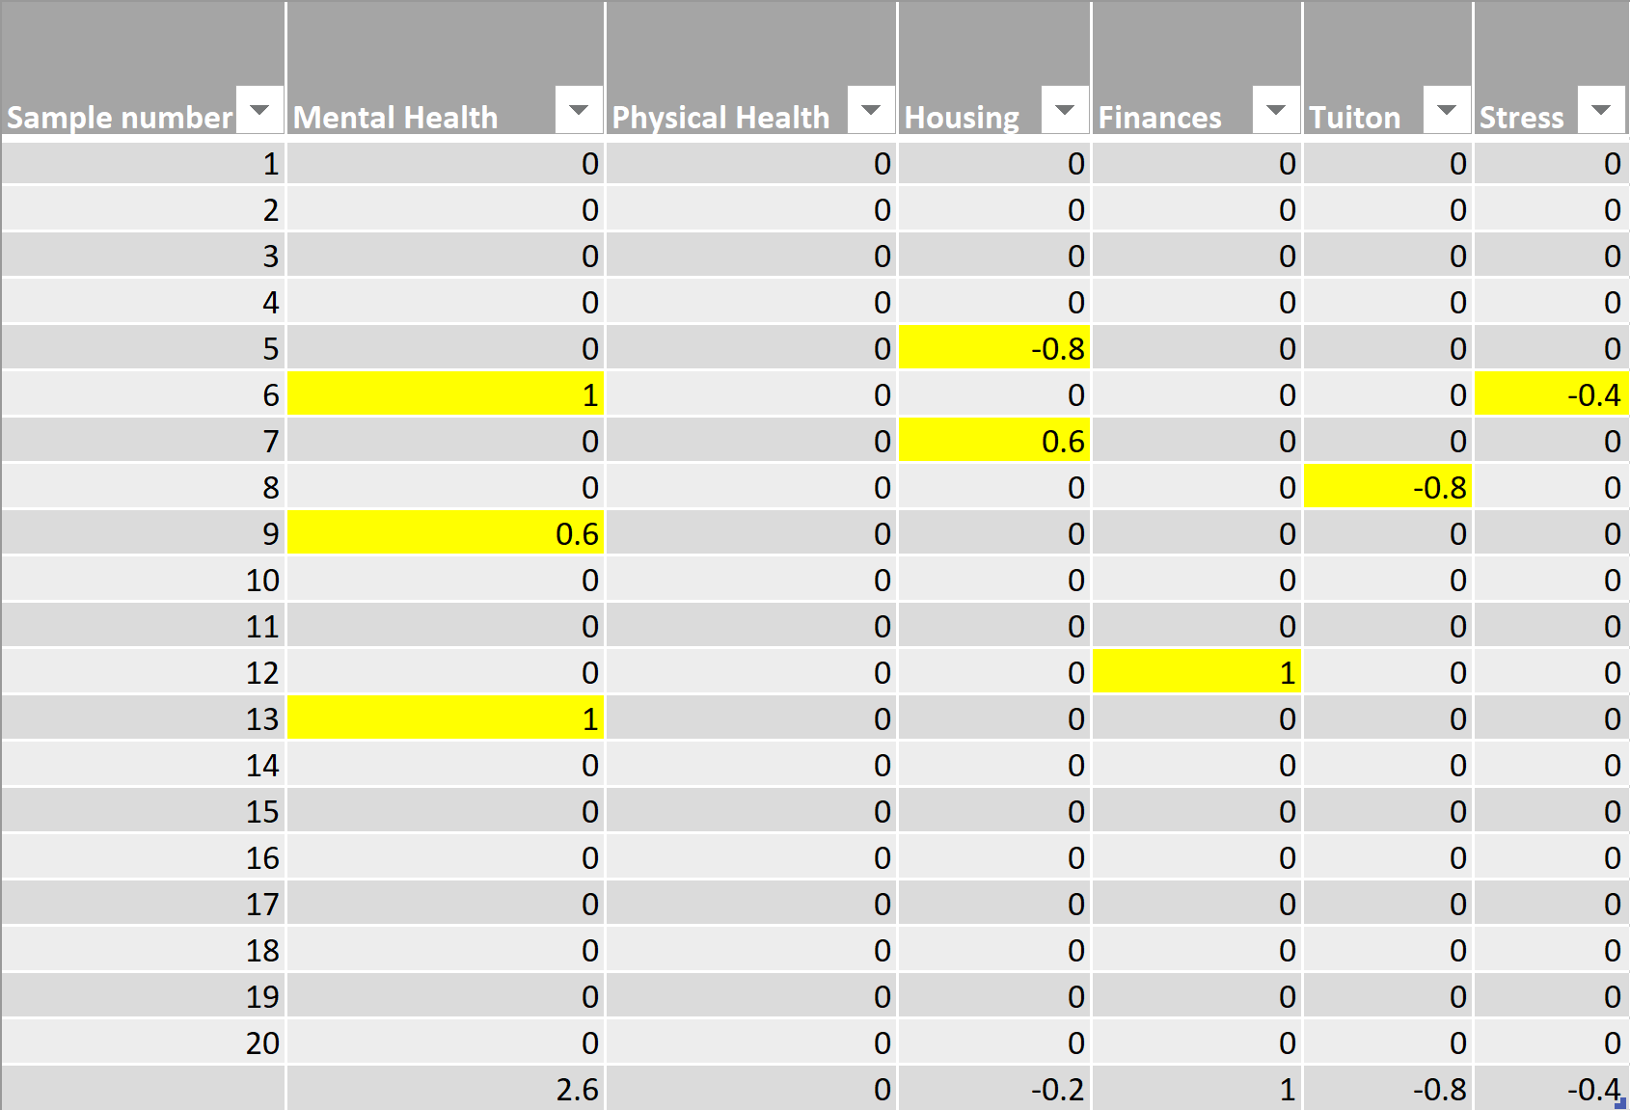
Correlations Continued (Part E)
The correlation map (on the previous slide) describes the correlation between individual student challenges and suggestions.
The following topics exhibit correlation for a subset of students:
Mental Health
Housing
Finances
Tuition
Stress

Slide 16
Correlations Conclusion (Part E)
Using the visualizations created from all our graphs, we can see that some students did have strong correlations between their challenges and suggestions.
We can see from our clustered graph that academics and motivation are strongly correlated, and from our correlation plot that mental health, housing, finances, tuition, and stress were also moderately to strongly correlated.
Referencing these features with our node graph, we see that physical health is connected to on campus food which signifies that multiple students likely are struggling with the same issues and could use help on those.
We can also reference our clusters and see that strongly correlated concerns/suggestions connect to other similar categories like mental health and social life (can also be seen on the clustered graph)
In conclusion, we can make use of all three of these visualizations to see how students are struggling and how they can be better helped. We can also use the matrix factorization from part D to see how some students with no responses for certain categories could possibly be helped as well.

Slide 17
Thank you! Questions?

